Slide 1

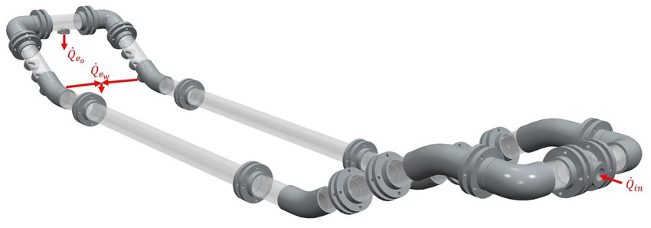
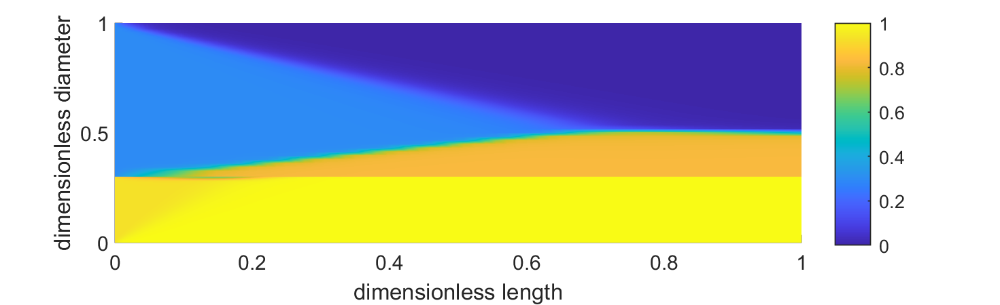



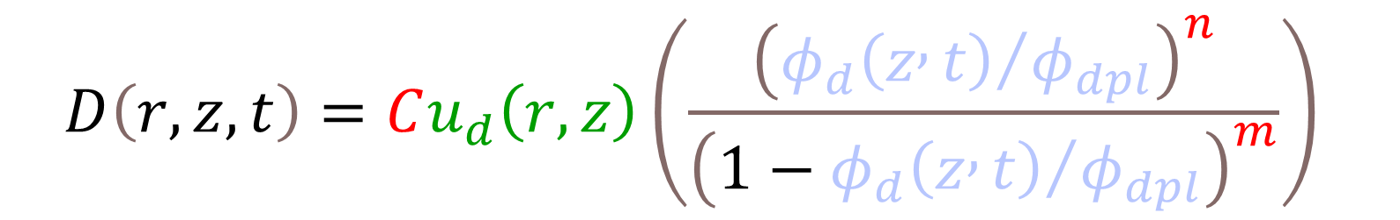
A NOVEL population balance model for subsea Multi-parallel pipes separator
Moein Assar¹ - Hamidreza Asaadian² - Milan Stanko² - Brian Arthur Grimes^{1*}
1 Ugelstad Laboratory, Department of Chemical Engineering, Norwegian University of Science and Technology (NTNU), N-7491 Trondheim, Norway.
2 Petroleumsteknisk senter, Norwegian University of Science and Technology (NTNU), N-7491 Trondheim, Norway.
*Corresponding author: brian.a.grimes@ntnu.no
1. INTRODUCTION
2. DENSE PACKED LAYER MODEL
Management of ever-increasing produced water is a critical issue for mature oil fields. Subsea separation using multi-parallel pipes (MPPS) is one viable solution to address this problem as it can reduce the load on topside facilities and gathering networks, allowing for increased production. Thus, this study develops a mathematical model for subsea Multi-parallel pipes separator. Population balance modelling is an indispensable part of the model to consider polydispersity in the system. Theoretically, the process consists of below phenomena.
Gravitational settling/rising ➔ Kumar and Hartland (1985)
Binary droplet coalescence ➔ Film drainage model
Interfacial coalescence ➔ Film drainage model
Dense packed layer formation ➔ Diffusion term
A vertical diffusion term is considered to model the formation of dense packed layer. The maximum volume fraction of dense-packed layer is included in this term which can incorporate the physical restriction of max volume fraction at dense-packed layer.
$$D\left(r,z,t\right)=Cu_{d}\left(r,z\right)\left(\frac{{\left({φ_{d}\left(z , t\right)}/{φ_{dpl}}\right)}^{n}}{{\left(1−{φ_{d}\left(z , t\right)}/{φ_{dpl}}\right)}^{m}}\right)$$
3. NUMERICAL ANALYSIS
Fig.1. Vertical diffusion versus volume fraction
Simultaneous coupling of the two phases layers.
Mass transfer between two phases layers and the effect on the velocities
4. RESULTS
Several experiments were performed under realistic conditions using a lab-scale multi-parallel pipes separator to study the effect of different volume fractions and flow rates on separation efficiency. The separation efficiency is given as the rate of water extracted to the amount of water theoretically possible to extract at the given extraction rate. In the experiments, colloidal dispersions were prepared using Exxsol D60-water mixture. To mimic the separation characteristics of real crude oil mixtures, small quantities of real crude were added to the Exxsol D60, a process called “crude oil spiking”.
Fig.2. Schematic of the gravitational separator model
Internal Domain
Spectral-element Orthogonal Collocation Technique
Legendre Jacobi polynomials
Grid size: 20 for no coalescence , 80 for coalescence
Spatial Dimension
High resolution FVM (MUSCL) based on reconstruction of the profile
Equidistance cells, grid size: 40
Steady-state solver
Transient solver (adaptive Gear’s Method)
Fig.5. Test Rig
Fig.6. Effect of flow rate and water cut on the Separation efficiency
c)
Fig.7. Water Volume fraction colormap, inlet WC=50%, flow rate=500 L/min
Fig.3. Spectral-element grid, top: system with no coalescence, bottom: coalescing system
Fig.4. Developed computational model library for transport and separation processes of oil-waxter emulsions
Fig.8. Hydrocarbon phase vertical profiles for volume fraction, average droplet radius and droplet radius standard deviation (top to bottom), inlet WC=50%, flow rate=500 L/min
5. CONCLUSIONS
6. ACKNOWLEDGMENTS
The developed model can be readily used in designing the subsea separators by liking the characterization information obtained from the experiments to large-scale industrial designs. The model provides promise for performing scale-ups as well as improvements of the existing designs.
This work was carried out as a part of SUBPRO, a Research-based Innovation Centre within Subsea Production and Processing. The authors gratefully acknowledge the financial support from SUBPRO, which is financed by the Research Council of Norway, major industry partners and NTNU.
REFERENCES
Kumar, A. & Hartland, S. (1985) Gravity settling in liquid/liquid dispersions, Canadian Journal of Chemical Engineering, 63(3), 368-376
SUBPRO SUBSEA PRODUCTION AND PROCESSING
Notes:
1

